Slide 1


The Role of Research Leaders on the Evolution of Scientific Communities
Bruno Leite Alves
Fabrício Benevenuto Alberto H. F. Laender
Federal University of Minas Gerais
Belo Horizonte, Brazil
Notes:
My name is Bruno Leite Alves and I will talk about the role of research leaders on the evolution of scientific communities.
This work was done with Fabrício Benevenuto and Alberto Laender.
We are from Federal University of Minas Gerais, from Belo Horizonte, Brazil.

Slide 2
My name is Bruno Leite Alves and I will talk about the role of research leaders on the evolution of scientific communities.
This work was done with Fabrício Benevenuto and Alberto Laender.
We are from Federal University of Minas Gerais, from Belo Horizonte, Brazil.

Slide 3
Society is Organized in Communities
There are a lot of kinds of communities
In a social networks, individuals influence and are influenced by others
Communities have opinion leaders
A group of leaders or influential members are able
to affect the dynamics of the entire community
Notes:
The society is organized in communities and there are a lot of kinds of communities, such as: fans of a sport, fans of a celebrity, friend’s communities, and scientific communities and so on.
We may name these communities as social networks, and inside of these social networks there are individuals who influence and are influenced by others.
There are a lot of works which point that these communities have leaders and these leaders are able to affect the opinion of other people. In this way, groups of leaders or influential are able to affect the dynamics of the entire communities.

Slide 4
The society is organized in communities and there are a lot of kinds of communities, such as: fans of a sport, fans of a celebrity, friend’s communities, and scientific communities and so on.
We may name these communities as social networks, and inside of these social networks there are individuals who influence and are influenced by others.
There are a lot of works which point that these communities have leaders and these leaders are able to affect the opinion of other people. In this way, groups of leaders or influential are able to affect the dynamics of the entire communities.

Slide 5
Our Goal
Study the dynamics of scientific communities
Identify leaderships within scientific communities (Community Core)
Investigate the properties of a Community Core
Notes:
Here, we want to identify leaders inside of scientific communities.
In this way, our goal is to study the dynamics of scientific communities and identify leaderships in these communities, here we named community core.
We are also interested in the properties of the community core.

Slide 6
Here, we want to identify leaders inside of scientific communities.
In this way, our goal is to study the dynamics of scientific communities and identify leaderships in these communities, here we named community core.
We are also interested in the properties of the community core.

Slide 7
Outline
Data Source about Scientific Communities
Extracting the Community Core
Properties of a Community Core
Notes:
So, the rest of the speech is organized as it follows.
Next, I am going to describe the data we used to study scientific communities.
Then, we describe how we extract the core of a community, and finally we present a series of analysis about the communities core.
This is the outline which we will follow.

Slide 8
So, the rest of the speech is organized as it follows.
Next, I am going to describe the data we used to study scientific communities.
Then, we describe how we extract the core of a community, and finally we present a series of analysis about the communities core.

Slide 9

Data Source
2.2 million publications
from 1.2 million authors
24 flagship conferences
of major ACM SIGs
We considered each conference
as a scientific community
Notes:
We used the DBLP data, a digital library with 2.2 million publications from 1.2 million authors.
As the DBLP has a lot of information, for a better analysis, we selected 24 flagship conferences of major ACM SIGs and we considered each conference as a scientific community.

Slide 10
We used the DBLP data, a digital library with 2.2 million publications from 1.2 million authors.
As the DBLP has a lot of information, for a better analysis, we selected 24 flagship conferences of major ACM SIGs and we considered each conference as a scientific community.

Slide 11
ACM SIGs Considered
SIGACT | SIGDOC | SIGMOD
SIGAPP | SIGGRAPH | SIGOPS
SIGARCH | SIGIR | SIGPLAN
SIGBED | SIGKDD | SIGSAC
SIGCHI | SIGMETRICS | SIGSAM
SIGCOMM | SIGMICRO | SIGSOFT
SIGCSE | SIGMM | SIGUCCS
SIGDA | SIGMOBILE | SIGWEB
Notes:
So, here it is possible to observe the 24 SIGs selected, all of our analysis are based in these conferences.
We have selected conferences with 10 years or more
SIGACT - Algorithms and Computation Theory
SIGAPP - Applied Computing
SIGARCH - Computer Architecture
SIGBED - Embedded Systems
SIGCHI - Computer-Human Interaction
SIGCOMM - Data Communication
SIGCSE - Computer Science Education
SIGDA - Design Automation
SIGDOC - Design of Communication
SIGGRAPH - Computer Graphics and Interactive Techniques
SIGIR - Information Retrieval
SIGKDD - Knowledge Discovery in Data
SIGMETRICS - Measurement and Evaluation
SIGMICRO - Microarchitecture
SIGMM - Multimedia
SIGMOBILE - Mobility of Systems, Users, Data and Computing
SIGMOD - Management of Data
SIGOPS - Operating Systems
SIGPLAN - Programming Languages
SIGSAC - Security, Audit and Control
SIGSAM - Symbolic and Algebraic Manipulation
SIGSOFT - Software Engineering
SIGUCCS - University and College Computing Services
SIGWEB - Hypertext and the Web

Slide 12
So, here it is possible to observe the 24 SIGs selected, all of our analysis are based in these conferences.
We have selected conferences with 10 years or more.

Slide 13
Core Score
Estimates a researcher’s importance within a community.
The core score of a researcher r into a community c in a period of time t is given by:
CoreScore_{r,c,t} = h_{r} × #publications_{r,c,t}
Notes:
In this context, which we would like to identify the most important members, we needed to quantify the importance of the researchers inside of communities.
So we defined this metric: Core Score. The core score estimates a researcher’s importance within a community and the core score of a researcher r into a community c in a specific time t is given by h-index of a researcher times the number of publications of a researcher into a community in a period of time.
An important piece of this metric is the h-index, so we needed to obtain this value.
H = h-index
R = research
C = conference (community)
T = Time
- A importantece piece to define the core score is h-index

Slide 14
In this context, which we would like to identify the most important members, we needed to quantify the importance of the researchers inside of communities.
So we defined this metric: Core Score. The core score estimates a researcher’s importance within a community and the core score of a researcher r into a community c in a specific time t is given by h-index of a researcher times the number of publications of a researcher into a community in a period of time.
An important piece of this metric is the h-index, so we needed to obtain this value.

Slide 15
How to Estimate H-index
Only 30%
of DBLP authors had a profile at
Google Scholar
Notes:
So, our first attempt (try) it was to use the Google Scholar, an important tool which is widely used among scientific communities to calculate the h-index.
For it, we randomly selected 10 researchers for each conference, but only 30% of DBLP authors had a profile at Google Scholar.

Slide 16
So, our first attempt (try) it was to use the Google Scholar, an important tool which is widely used among scientific communities to calculate the h-index.
For it, we randomly selected 10 researchers for each conference, but only 30% of DBLP authors had a profile at Google Scholar.

Slide 17

How to Estimate H-index
Only 30%
of DBLP authors had a profile at
Google Scholar
Alternative
www.shine.icomp.ufam.edu.br
Notes:
Then we used Shine data.
Shine project is a tool which makes the estimation of h-index of conferences.
They use the number of references of the papers to estimate the h-index, so we match this information with DBLP and we infer the h-index of the researchers.

Slide 18
Then we used Shine data.
Shine project is a tool which makes the estimation of h-index of conferences.
They use the number of references of the papers to estimate the h-index, so we match this information with DBLP and we infer the h-index of the researchers.

Slide 19
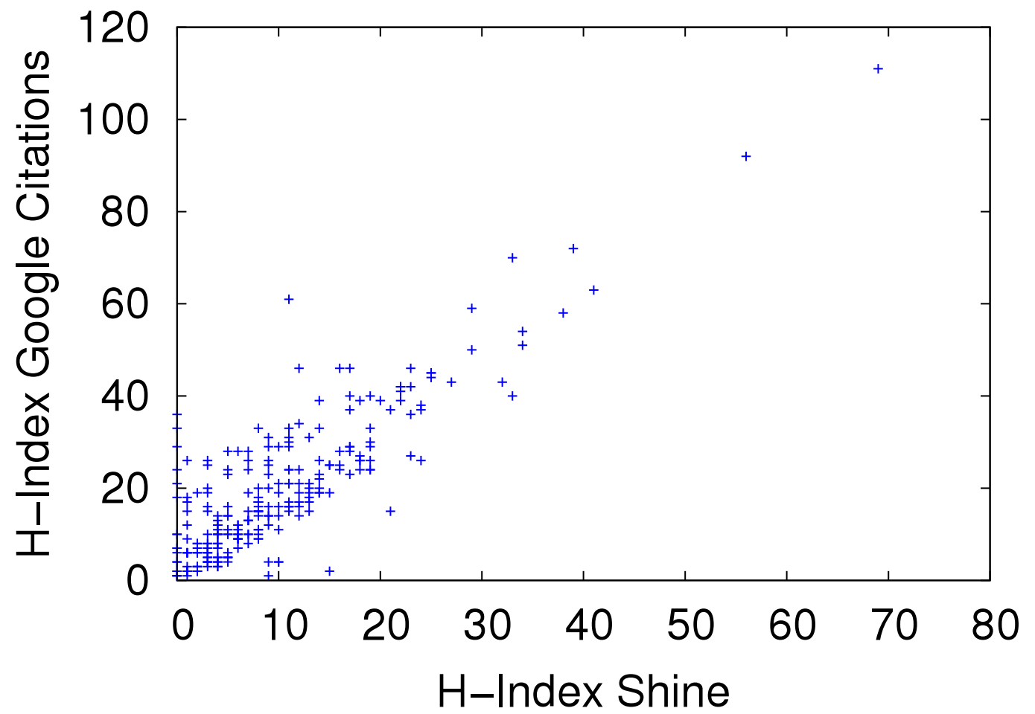
Shine vs. Google Scholar
Pearson Correlation Coefficient = 0.85
Shine offers a good estimation for H-Index
Notes:
To validate this estimative, we calculated the Pearson correlation coefficient.
It is possible to note in the graphic and the value of Pearson Coefficient a strong positive correlation between the inferred value and Google Scholar value.
So, Shine offers a good estimation for H-Index.

Slide 20
To validate this estimative, we calculated the Pearson correlation coefficient.
It is possible to note in the graphic and the value of Pearson Coefficient a strong positive correlation between the inferred value and Google Scholar value.
So, Shine offers a good estimation for H-Index.

Slide 21
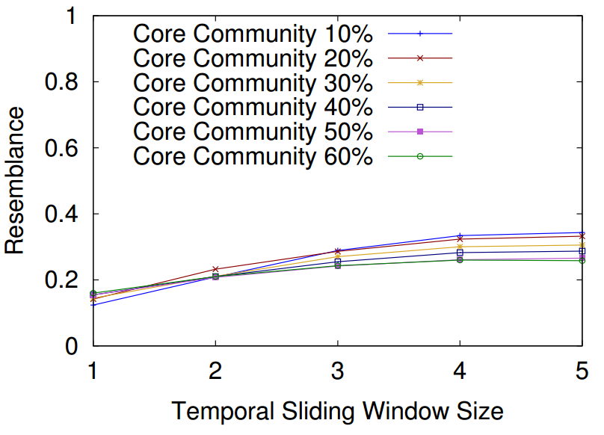
Resemblance and Angular Coefficient
SIGMOD
Notes:
After it was done, we needed to define two important thresholds to extract the core community.
The first one is the size of core community, once we have a ranking based in the core score.
The second one is the temporal sliding window size to analyze the core community over the time.
We used the resemblance and angular coefficient to help us. The resemblance is a measure which identifies the change in the network over the time and angular coefficient is responsible to identify the inclination of the lines.

Slide 22
After it was done, we needed to define two important thresholds to extract the core community.
The first one is the size of core community, once we have a ranking based in the core score.
The second one is the temporal sliding window size to analyze the core community over the time.
We used the resemblance and angular coefficient to help us. The resemblance is a measure which identifies the change in the network over the time and angular coefficient is responsible to identify the inclination of the lines.

Slide 23
Resemblance and Angular Coefficient
SIGMOD
Notes:
After the calculations we defined the core community size as 10% and the temporal sliding window size as 3 years. Here it is possible to observe the SIGMOD conference, but the other conferences follow the same behavior.

Slide 24
After the calculations we defined the core community size as 10% and the temporal sliding window size as 3 years. Here it is possible to observe the SIGMOD conference, but the other conferences follow the same behavior.

Slide 25
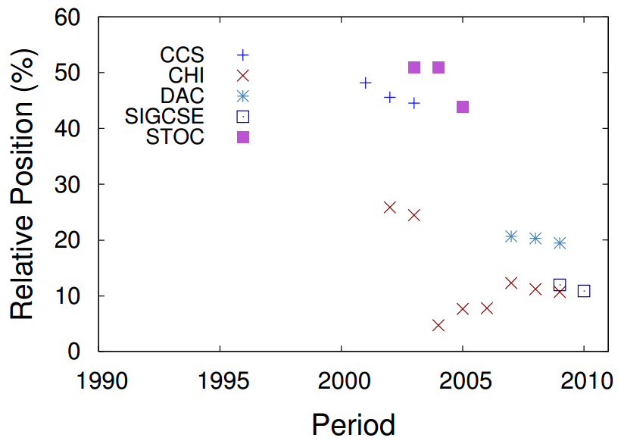
Luis von Ahn’s Communities
Three years window
High core score in CHI and SIGCSE
Notes:
We would like to validate the ranking of the core score, so we selected two important researchers of scientific communities, the first one is Luis von Ahn, the keynote speaker of this conference this year. Here, we may note the core score of Luis von Ahn’s communities.
Luis has a high core score in CHI and SIGCSE.
CCS - Conference on Computer and Communications Security
CHI - Conference on Human Factors in Computing Systems
DAC – Design Automation Conference
SIGCSE - Special Interest Group on Computer Science Education
STOC – Symposium on Theory of Computing

Slide 26
We would like to validate the ranking of the core score, so we selected two important researchers of scientific communities, the first one is Luis von Ahn, the keynote speaker of this conference this year. Here, we may note the core score of Luis von Ahn’s communities.
Luis has a high core score in CHI and SIGCSE.

Slide 27
Luis von Ahn’s Communities
Community Core
Three years window
Member of the Community Core of CHI
Notes:
We may see here that Luis became part of community core of CHI and he was close to become part of the community core of conferences as SIGCSE and after DAC.
CCS - Conference on Computer and Communications Security
CHI - Conference on Human Factors in Computing Systems
DAC – Design Automation Conference
SIGCSE - Special Interest Group on Computer Science Education
STOC – Symposium on Theory of Computing

Slide 28
We may see here that Luis became part of community core of CHI and he was close to become part of the community core of conferences as SIGCSE and after DAC.

Slide 29
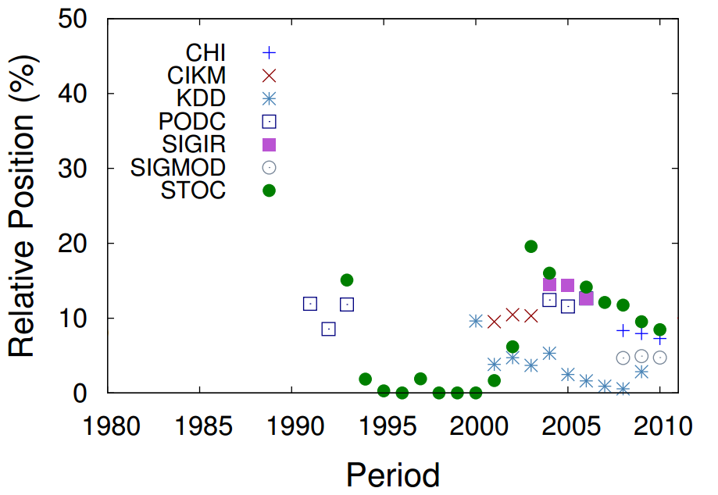
Jon Kleinberg’s Communities
Three years window
High core score in several communities
Notes:
Other important researcher and keynote speaker is Jon Kleinberg (Klaiber). We may observe Jon Kleinberg as member of the community core of several conferences.
CHI - Conference on Human Factors in Computing Systems
CIKM - Conference on Information and Knowledge Management
KDD – Knowledge, Discovery, and Data Mining
PODC - Symposium on Principles of Distributed Computing
SIGIR – Special Interest Group on Information Retrieval
SIGMOD – Special Interest Group on Management of Data
STOC – Symposium on Theory of Computing

Slide 30
Other important researcher and keynote speaker is Jon Kleinberg (Klaiber). We may observe Jon Kleinberg as member of the community core of several conferences.

Slide 31
Jon Kleinberg’s Communities
Community Core
Three years window
Moving from STOC to KDD
Notes:
It is possible note Jon Kleinberg moving from STOC to KDD and other conferences.
CHI - Conference on Human Factors in Computing Systems
CIKM - Conference on Information and Knowledge Management
KDD – Knowledge, Discovery, and Data Mining
PODC - Symposium on Principles of Distributed Computing
SIGIR – Special Interest Group on Information Retrieval
SIGMOD – Special Interest Group on Management of Data
STOC – Symposium on Theory of Computing

Slide 32
It is possible note Jon Kleinberg moving from STOC to KDD and other conferences.

Slide 33
Awarded Researchers
Members of the core community awarded
Notes:
A second validate we proposed is to identify conference which was awarded as the best researcher and observe whether these researchers were members of the community core.
It is possible to observe a high number of members of community core awarded in SIGMOD, KDD and SIGIR.
In SIGCOMM case, several researchers appeared in SIGCOMM sponsors conference.
SIGMOD - Management of Data
SIGKDD - Knowledge Discovery in Data
SIGIR - Information Retrieval
SIGCOMM - Data Communication

Slide 34
A second validate we proposed is to identify conference which was awarded as the best researcher and observe whether these researchers were members of the community core.
It is possible to observe a high number of members of community core awarded in SIGMOD, KDD and SIGIR.
In SIGCOMM case, several researchers appeared in SIGCOMM sponsors conference.

Slide 35
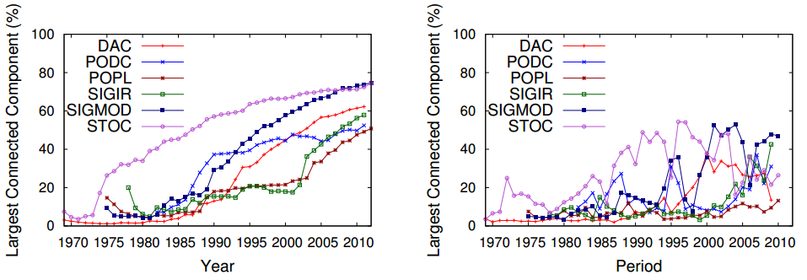
Evolution of the Scientific Communities
Year by year by accumulating nodes and edges
Notes:
Our analyses are performed under two perspectives.
The first consists on analyzing the network evolution year by year by accumulating nodes and edges to a single final snapshot of the graph.
We may observe the size of largest connected component, in generally, grow up over the time.
DAC – Design Automation Conference
PODC - Symposium on Principles of Distributed Computing
POPL - Symposium on Principles of Programming Languages
SIGIR – Special Interest Group on Information Retrieval
SIGMOD – Special Interest Group on Management of Data
STOC – Symposium on Theory of Computing

Slide 36
Our analyses are performed under two perspectives.
The first consists on analyzing the network evolution year by year by accumulating nodes and edges to a single final snapshot of the graph.
We may observe the size of largest connected component, in generally, grow up over the time.

Slide 37
Evolution of the Scientific Communities
Three years window
Snapshots (3 years) constructed based on nodes and edges
Notes:
The second perspective consists of analyzing snapshots constructed based on nodes and edges created on a predefined time window.
Here, using the sliding window, we can note the variation over years.
This motivated us to investigate the role of core community in this case.
DAC – Design Automation Conference
PODC - Symposium on Principles of Distributed Computing
POPL - Symposium on Principles of Programming Languages
SIGIR – Special Interest Group on Information Retrieval
SIGMOD – Special Interest Group on Management of Data
STOC – Symposium on Theory of Computing

Slide 38
The second perspective consists of analyzing snapshots constructed based on nodes and edges created on a predefined time window.
Here, using the sliding window, we can note the variation over years.
This motivated us to investigate the role of core community in this case.

Slide 39
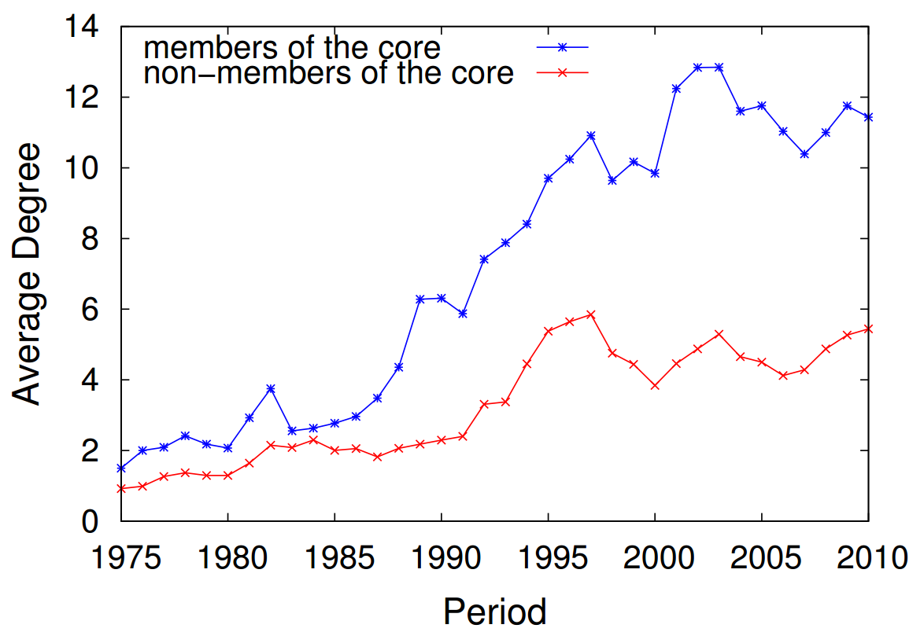
Core Members vs. Non-Members
Three years window
Average degree of core members is higher than those of non-members’
Notes:
The focus of this work is to understand the effects of the community core in the properties of the networks, so, using the sliding windows, we can perceive that average degree is higher for core members than non-members.

Slide 40
The focus of this work is to understand the effects of the community core in the properties of the networks, so, using the sliding windows, we can perceive that average degree is higher for core members than non-members.

Slide 41
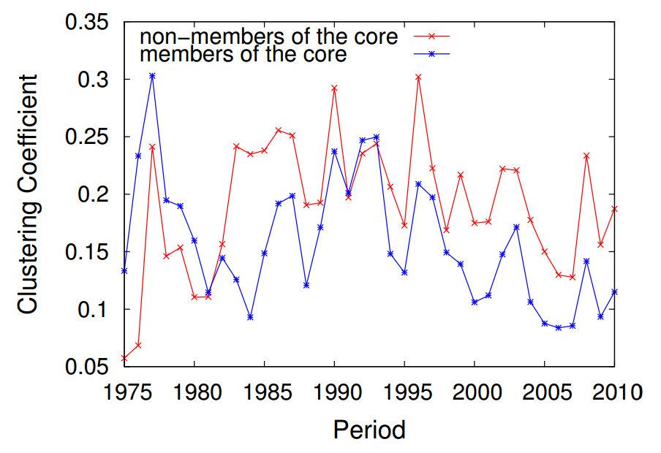
Core Members vs. Non-Members
Three years window
The core might act like hubs, by connecting different groups with small intersection
Notes:
Differently from the average degree, the clustering coefficient is smaller in community core, so the core might act like hubs in the network, by connecting different groups with small intersection.

Slide 42
Differently from the average degree, the clustering coefficient is smaller in community core, so the core might act like hubs in the network, by connecting different groups with small intersection.

Slide 43
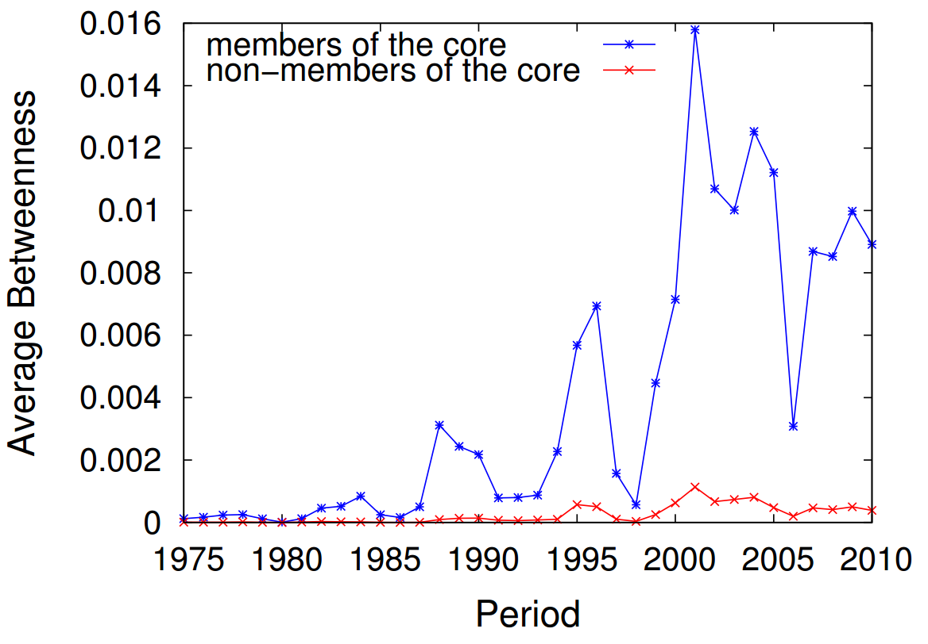
Core Members vs. Non-Members
Three years window
A higher number of shortest paths include the core
Notes:
So, to identify if the members of community core are hubs, we calculated the betweenness of the community core.
The betweenness show which a higher number of shortest paths include the core. It confirms that members of community core are hubs.

Slide 44
So, to identify if the members of community core are hubs, we calculated the betweenness of the community core.
The betweenness show which a higher number of shortest paths include the core. It confirms that members of community core are hubs.

Slide 45
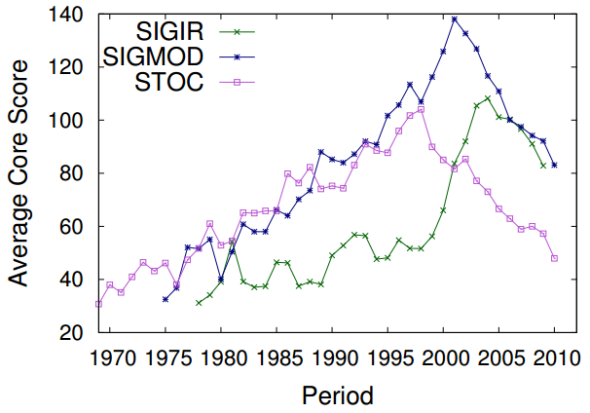
Influence of Core Members
Three years window
The average core score of a community, in general, rises along its life time
Notes:
To understand how the core score evolves over the time, we propose this metric, the average core score. The average core score of a community, in general, rises along its life time.
SIGIR – Special Interest Group on Information Retrieval
SIGMOD – Special Interest Group on Management of Data
STOC – Symposium on Theory of Computing

Slide 46
To understand how the core score evolves over the time, we propose this metric, the average core score. The average core score of a community, in general, rises along its life time.

Slide 47
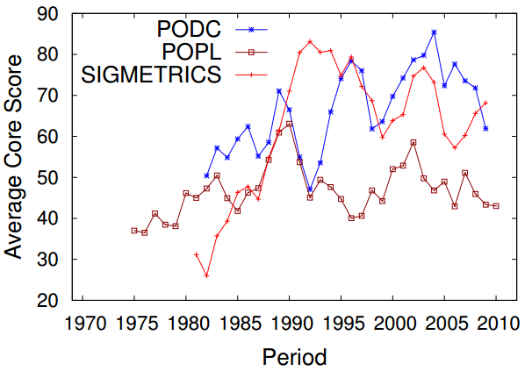
Influence of Core Members
Three years window
How does it affect the network?
Notes:
Here is possible observe a similar behavior, but How does it affect the network?
PODC - Symposium on Principles of Distributed Computing
POPL - Symposium on Principles of Programming Languages
SIGMETRICS - Measurement and Evaluation

Slide 48
Here is possible observe a similar behavior, but How does it affect the network?

Slide 49
Strong Correlation with Average Core Score
Average Degree
0.59
Large WCC
0.5
Average Short Path
0.49
Diameter
0.49
-0.11
Clustering Coefficient
-0.56
Assortativity
Notes:
In this way, we calculated the correlation between the average core score and other complex networks metrics.
Except for clustering coefficient, every metric has a strong correlation with average core score, in other words, if we increase or decrease the average core score, these metrics also change.

Slide 50
In this way, we calculated the correlation between the average core score and other complex networks metrics.
Except for clustering coefficient, every metric has a strong correlation with average core score, in other words, if we increase or decrease the average core score, these metrics also change.

Slide 51
Conclusions
The core community:
is strongly correlated with variations on network properties
works as bridges that connect groups
increases the average degree
decreases the assortativeness
Notes:
Well, with this work, we conclude that:
The core community work as bridges that connect smaller clustered research groups, and finally, the core community tends to increase the average degree of the network and decrease the assortativeness.

Slide 52
Well, with this work, we conclude that:
The core community work as bridges that connect smaller clustered research groups, and finally, the core community tends to increase the average degree of the network and decrease the assortativeness.

Slide 53
Conclusions
Future Work:
Analysis of other kinds of network such as massive multiplayer games and on-line social networks
Estimation of the h-index as a function of time
Notes:
As future work we propose to make analysis of other kinds of network such as massive multiplayer games and on-line social networks, and to estimate the h-index as a function of time.

Slide 54
As future work we propose to make analysis of other kinds of network such as massive multiplayer games and on-line social networks, and to estimate the h-index as a function of time.

Slide 55
Thank you!
Bruno Leite Alves Fabrício Benevenuto Alberto H. F. Laender
Computer Science Department
Federal University of Minas Gerais
{bruno.leite,fabricio,laender@dcc.ufmg.br}
Notes:
Thank you very much!

Slide 56
Thank you very much!

